Slide 1


Online Automated Placement Management System
By
Mr. Sagar Patel(PG-DAC)
MR.SURAJ RAJPUT(PG-DAC)
Centre Coordinator Under the guidance of
Mr. Prashant Karhale MR.Kashinath PATIL Sir

Slide 2
Introduction
This project is aimed at developing an online application for the Training and Placement Dept. of the college.
The system is an online application that can be accessed throughout the organization and outside as well with proper login provided.
Visitors/Company representatives logging in may also access/search any information put up by Students. update their password if needed.
Company can arrange Drive in this system and which can be verify by Training Placement Officer (TPO).
After verifying the drive the status of drive will be updated automatically and the list of students, company can see in it feedback menu and student can see drive detail on their drive menu .
After conducting campus drive company can give feedback by post list of selected student after posting the list of selected student selected student status will be updated automatically.
This system can be used as an application for the TPO of the college to manage the student information with regards to placement.
Students logging should be able to upload their Information .

Slide 3
Objective
The purpose of the “Online Automated Placement Management System”, the manual work makes the process slow and other problems such as inconsistency and ambiguity on operations.
In order to avoid this placement managed system is proposed, where the student information in the college with regard to placement is managed efficiently.
It intends to help fast in fast access procedures in placement related activities and ensures to maintain the details of the student.

Slide 4
Hardware and Software Requirement
Operating System : Windows xp.
Language : java (jdk1.8.0) /swing.
Database : MySQL
Processor :Intel Pentium Dual-Core

Slide 5
Analysis
During analysis data is collected on the various files.
Analyzing tools for structured analysis.
The detailed studies carried out to check the work ability of proposed system.
Too much the paper work.
Chances of mistake due to large amount of information.
Too much time required for maintaining records.

Slide 6
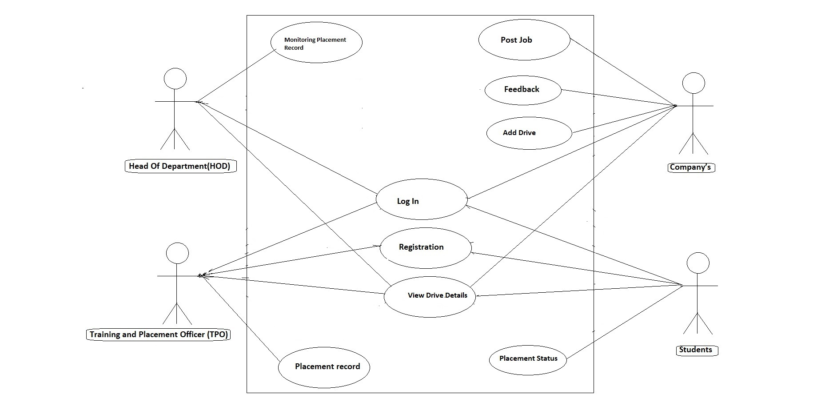
Use-case Diagram

Slide 7
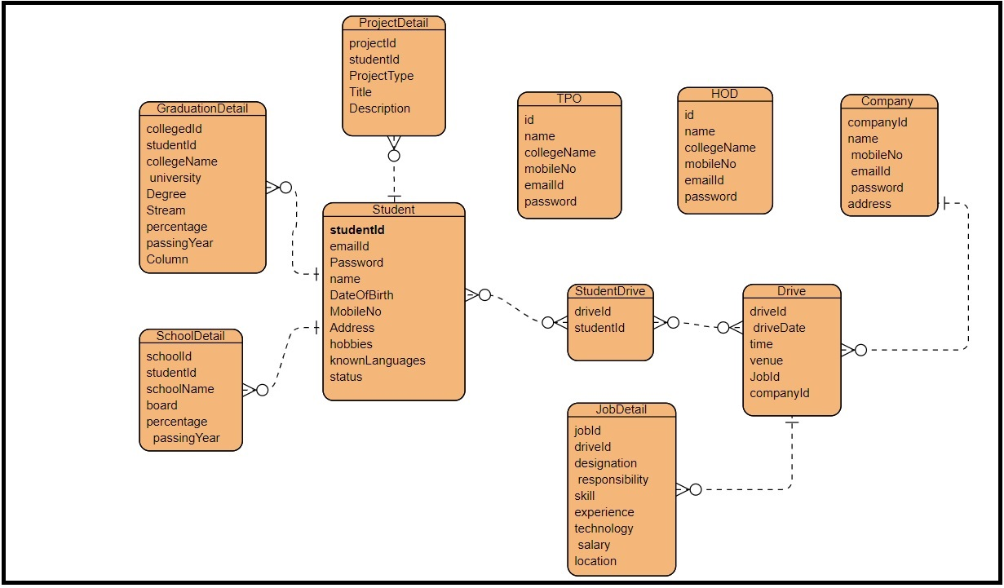
Entity relationship diagram

Slide 8
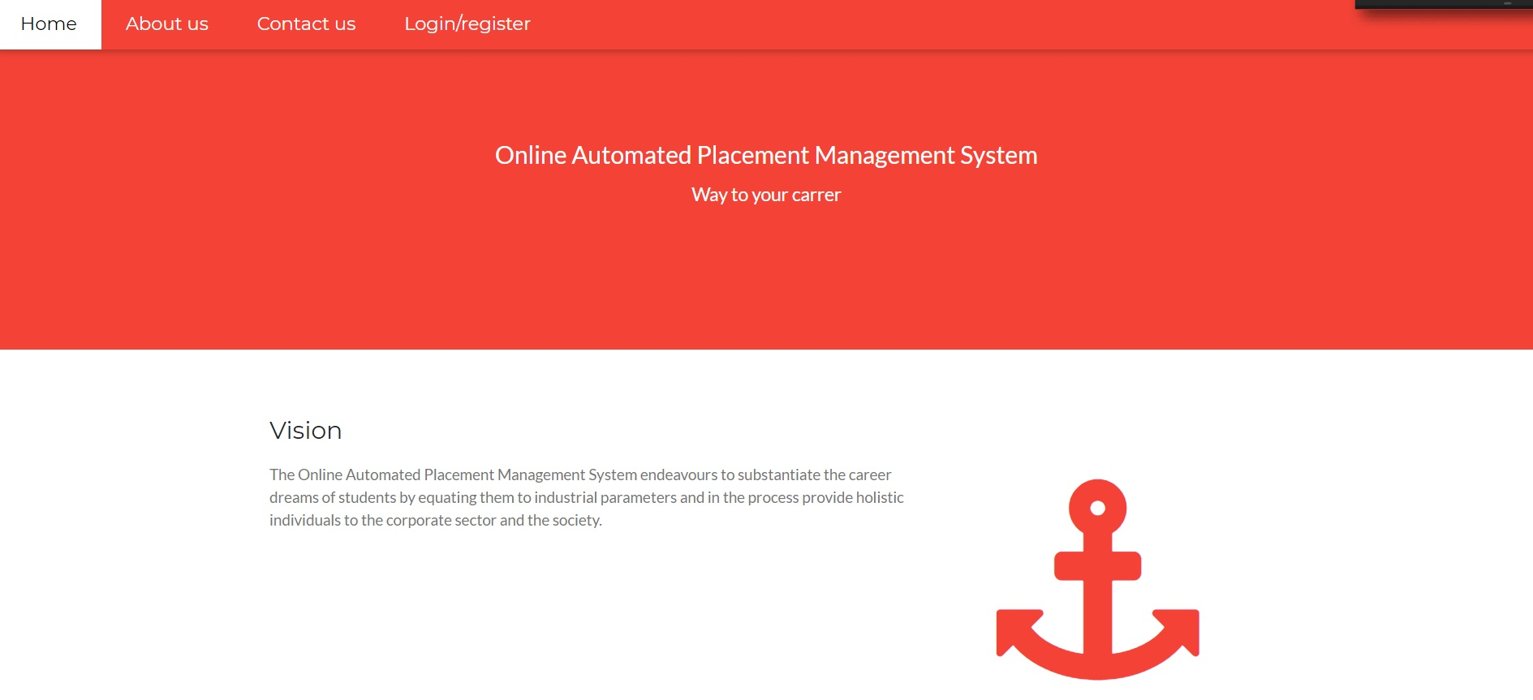
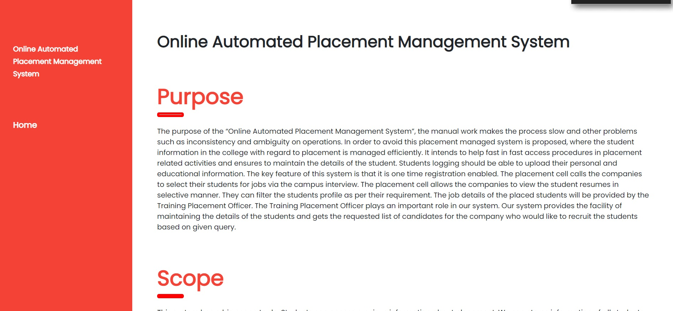
Home Page and About Us Page

Slide 9
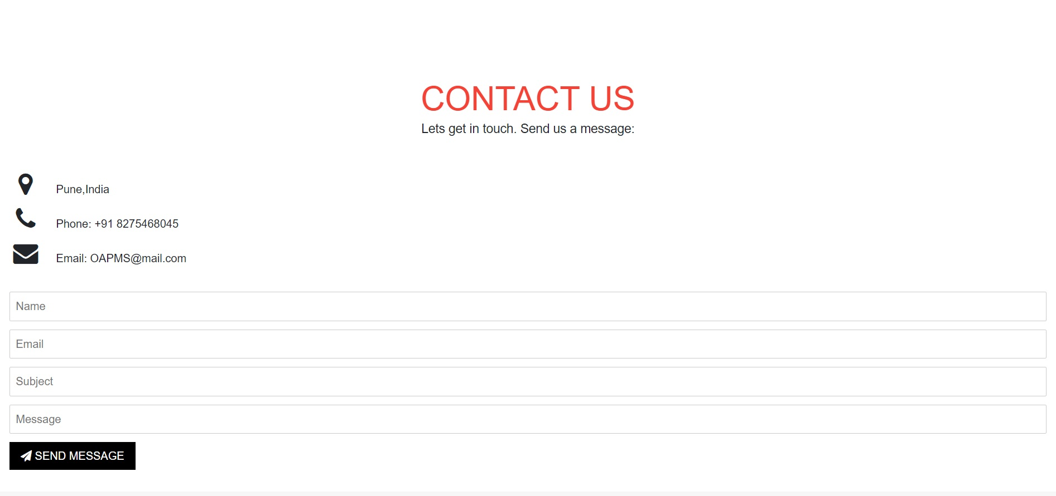
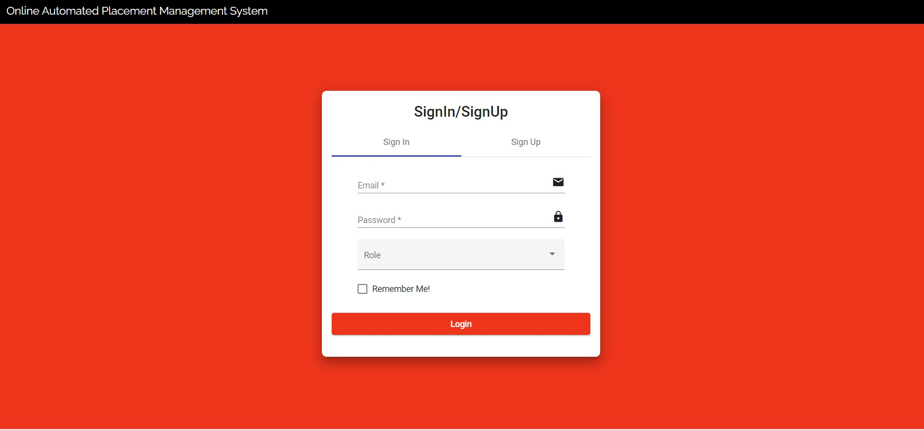
Contact us page and Login Page
Contact us
Login Page

Slide 10
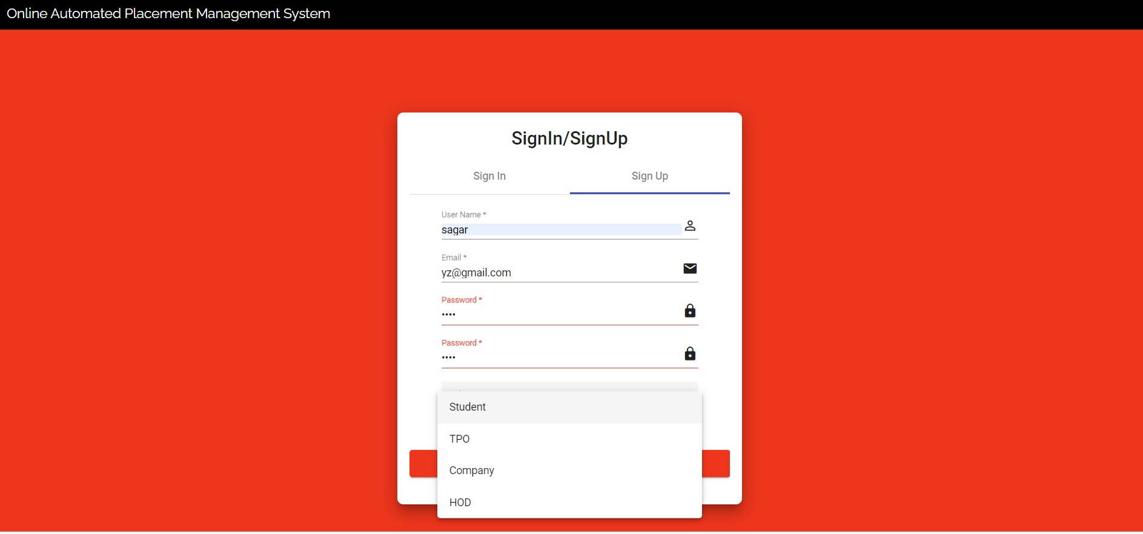
Role User Registration

Slide 11
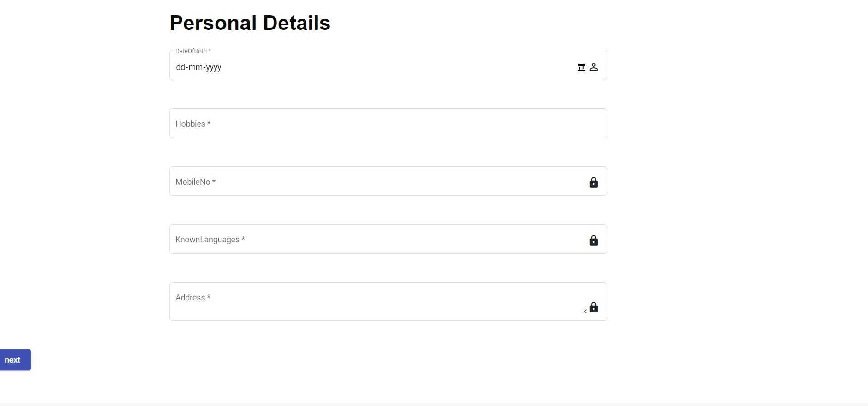
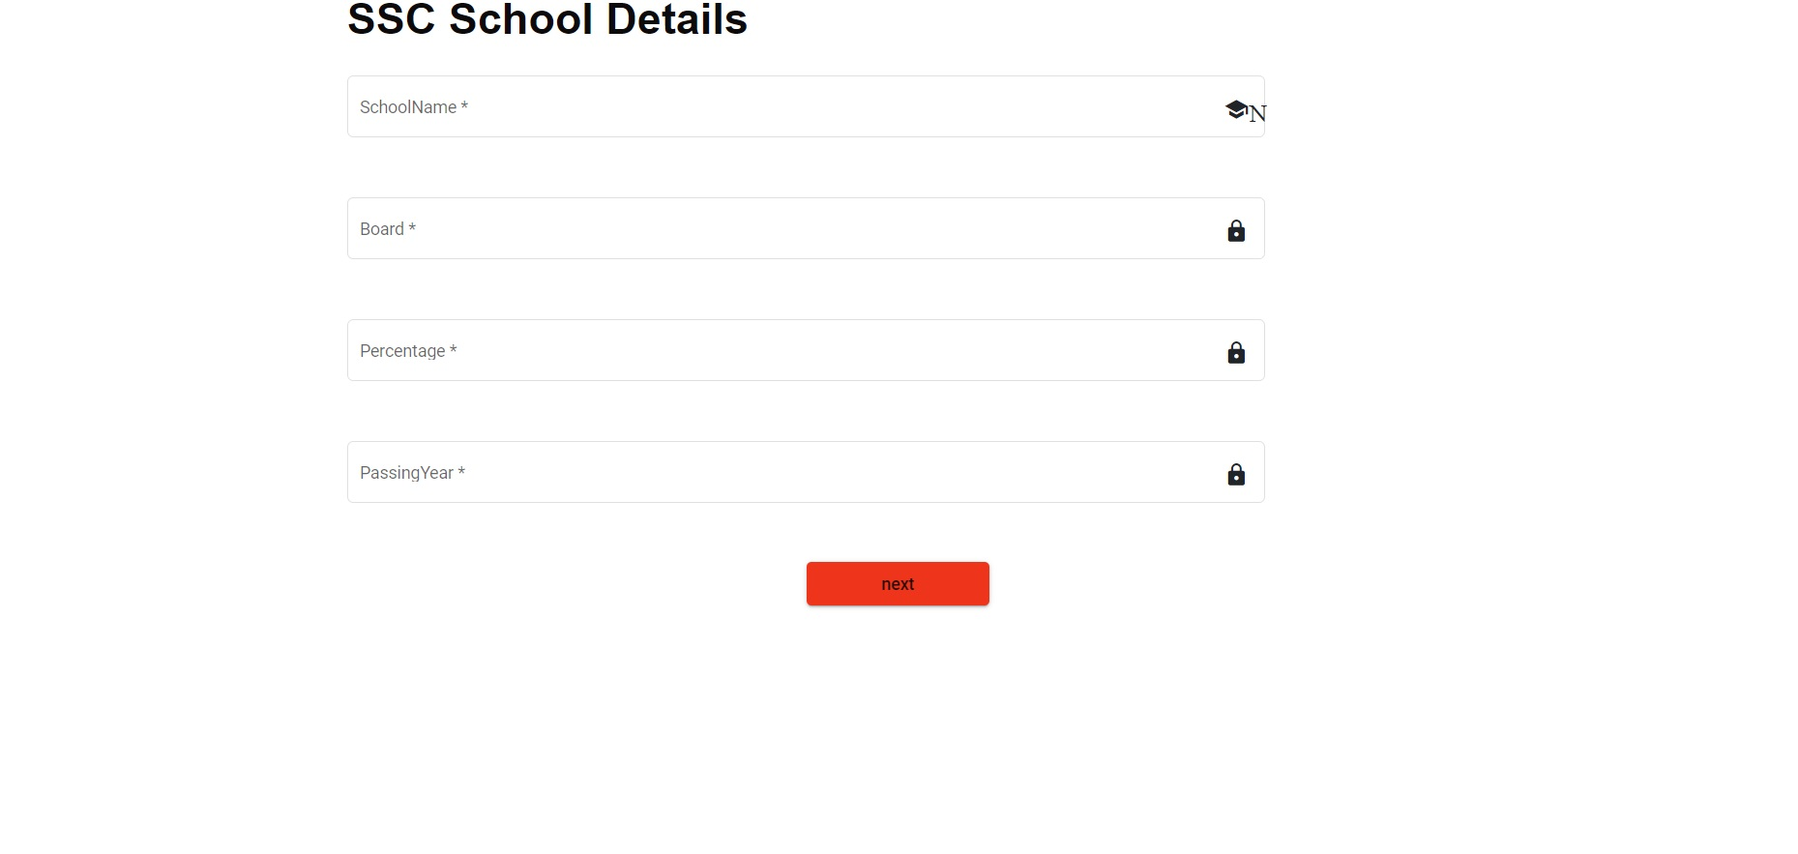
Student Registration
SCC SCHOOL DETAILS
Personal Details

Slide 12
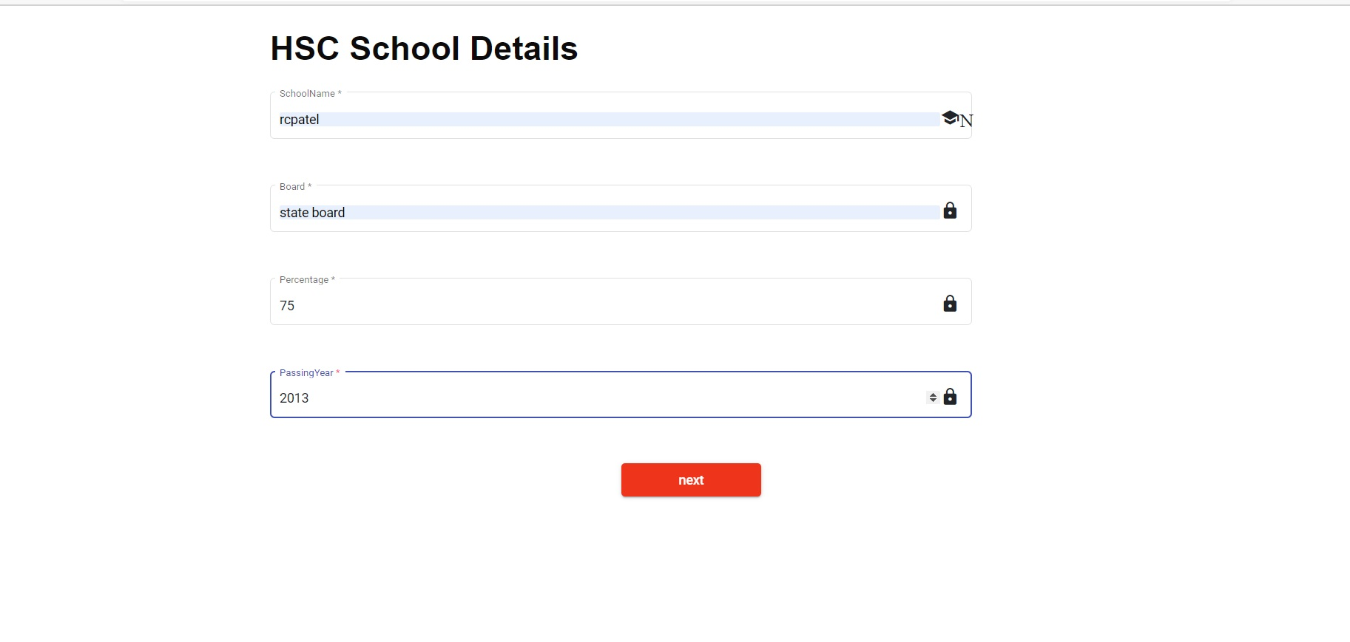
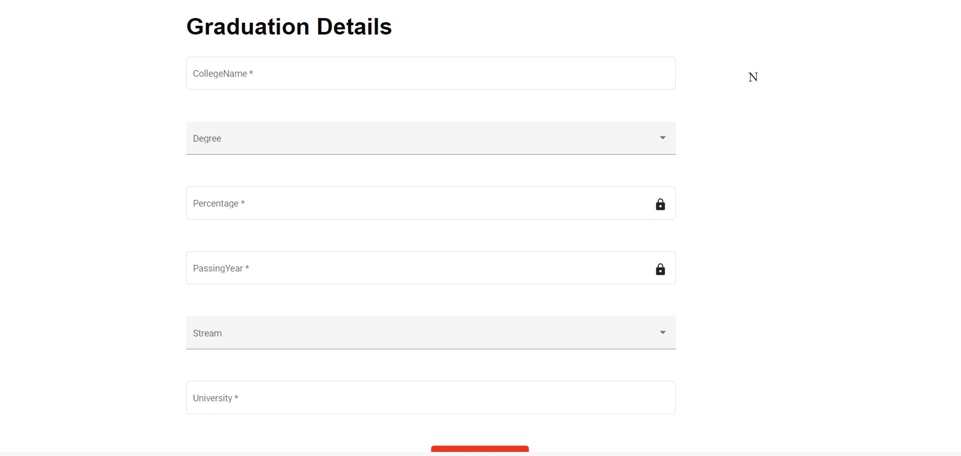
Student Registration
Graduation details
hSC SCHOOL DETAILS

Slide 13
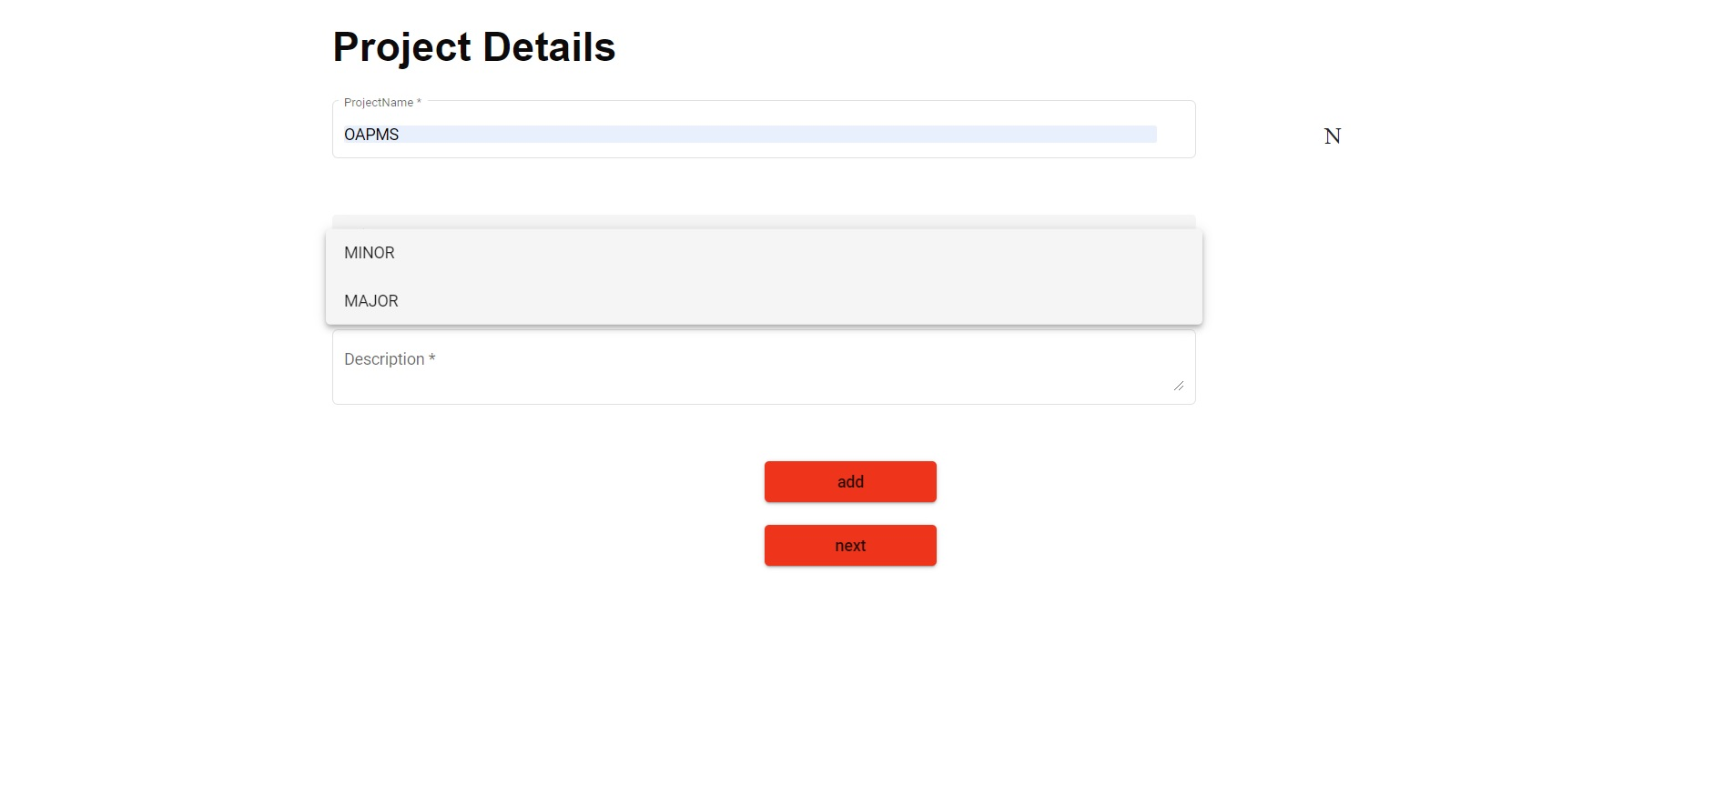
Student Registration

Slide 14
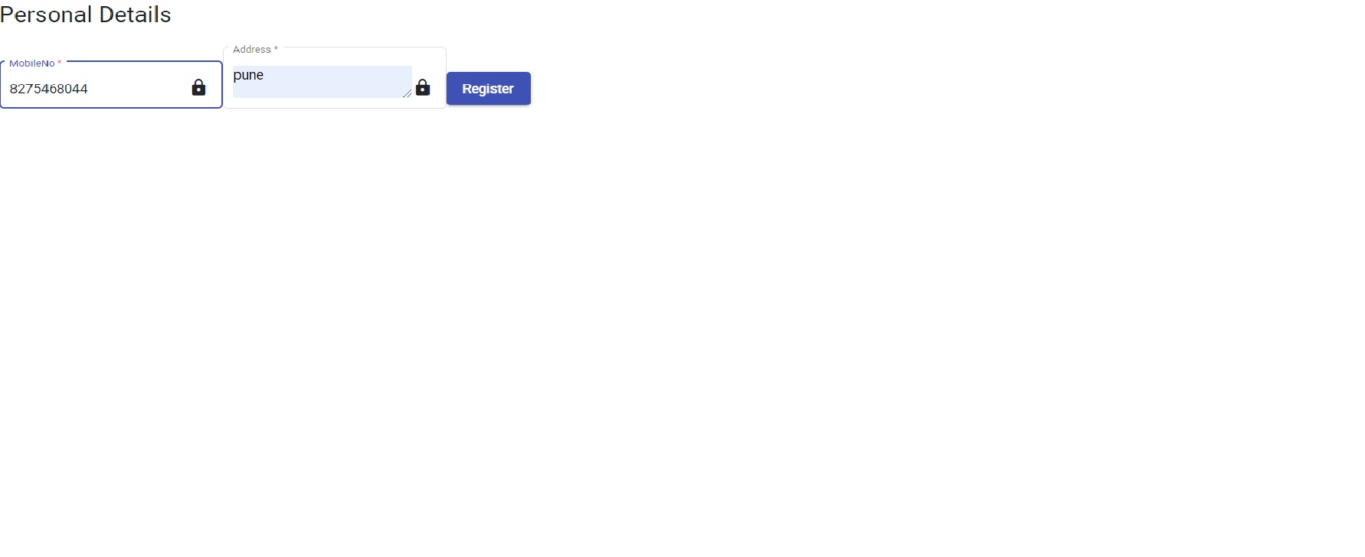
Company Registration

Slide 15
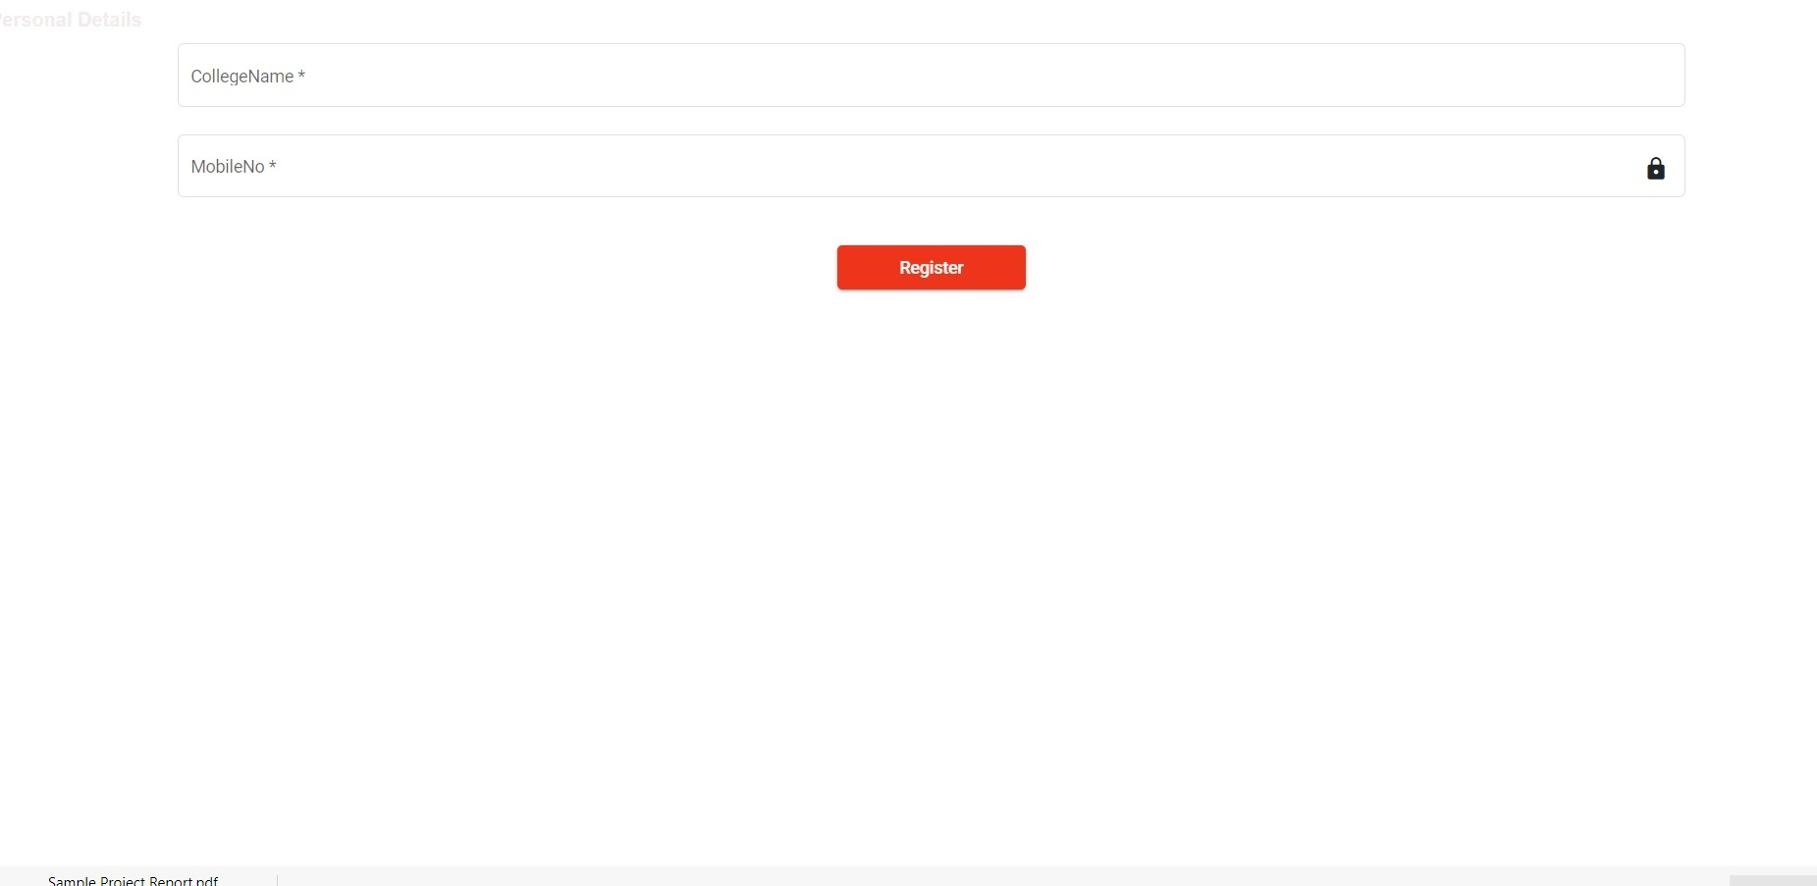
Training placement officer Registration

Slide 16
Head Of department Registration

Slide 17
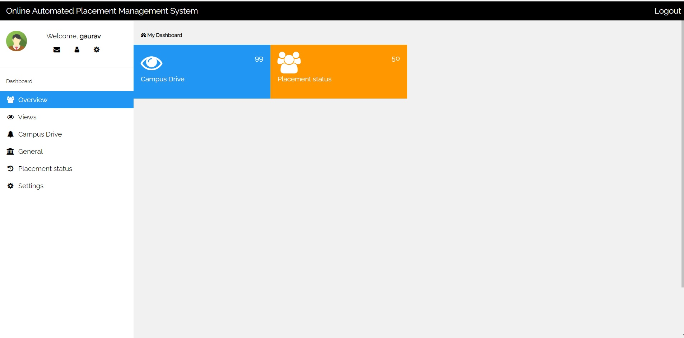
Student Dashboard

Slide 18
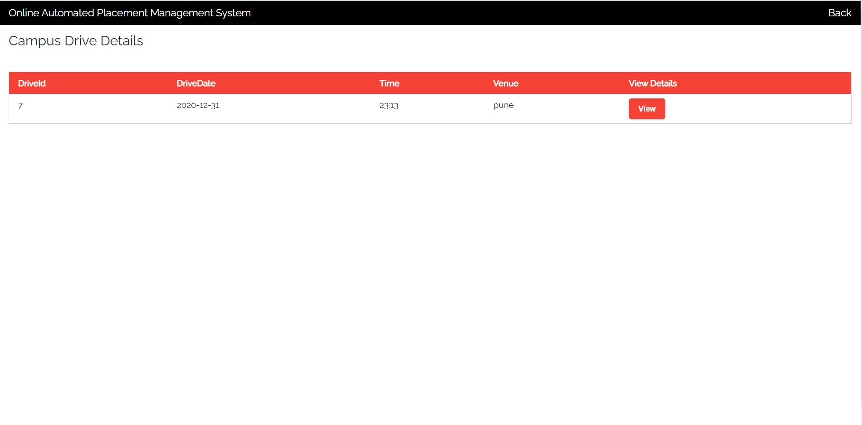
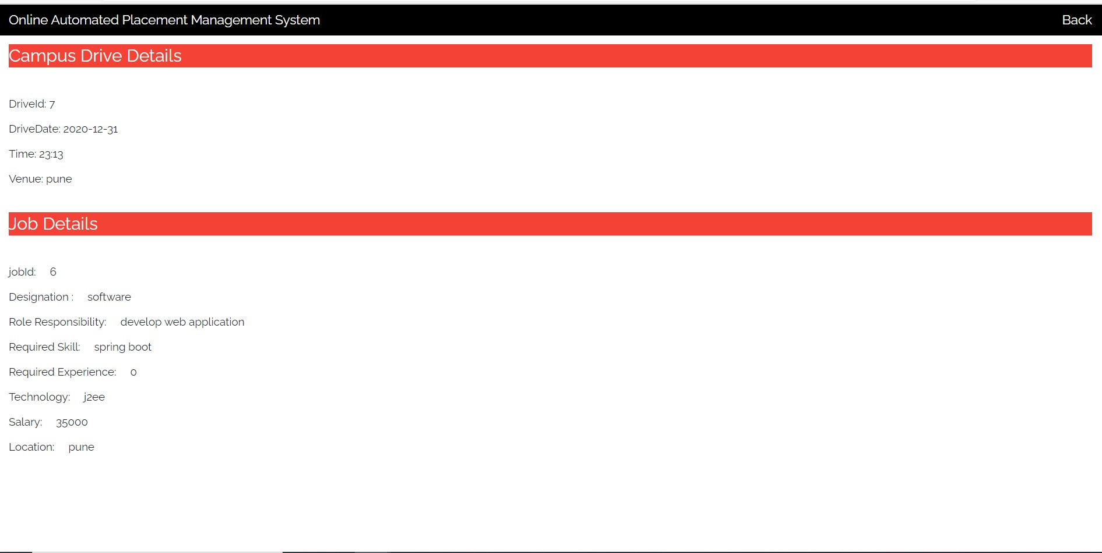
Student functionality
Campus drive
View drive details

Slide 19
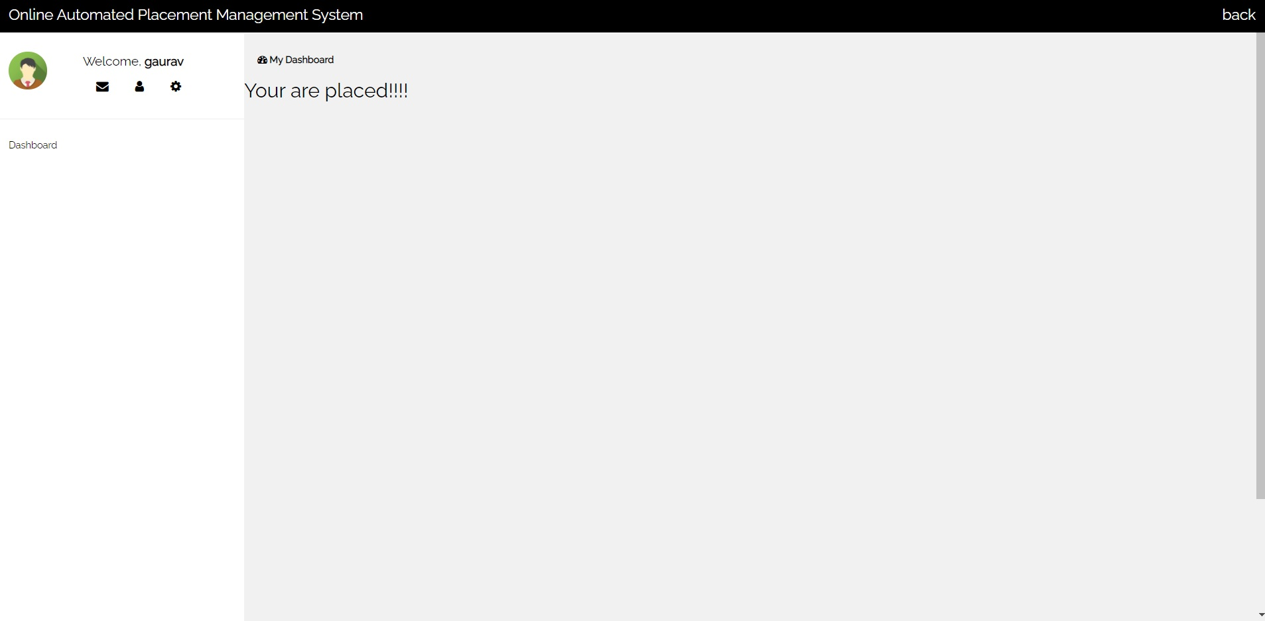
Student functionality
PLACEMENT STATUS

Slide 20
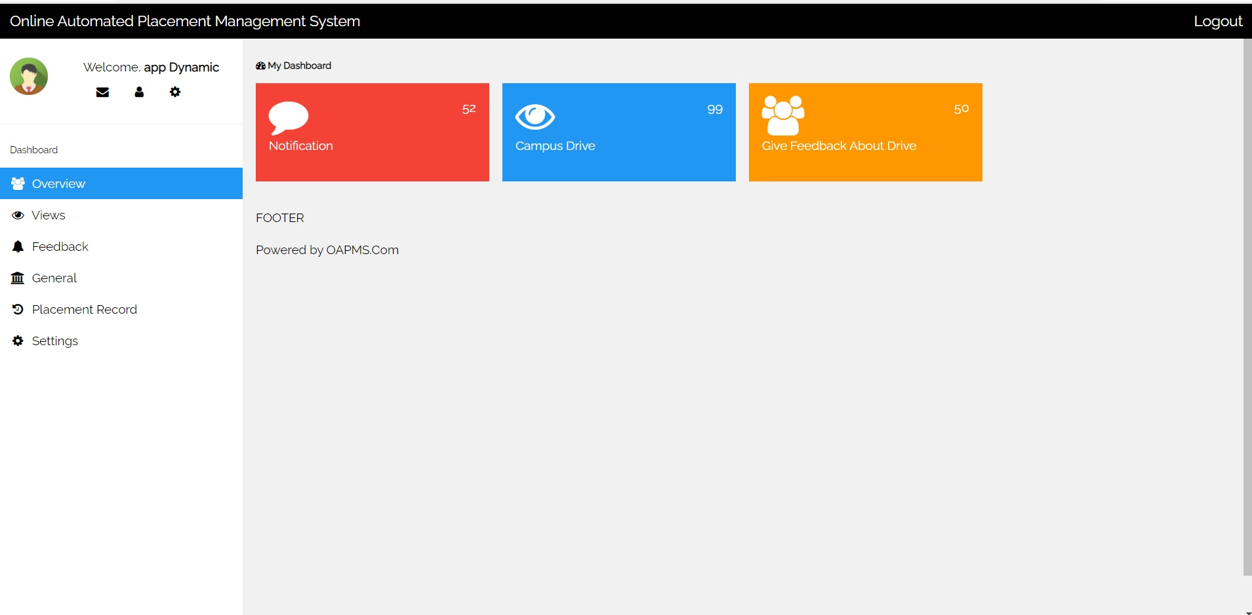
Company Dashboard

Slide 21
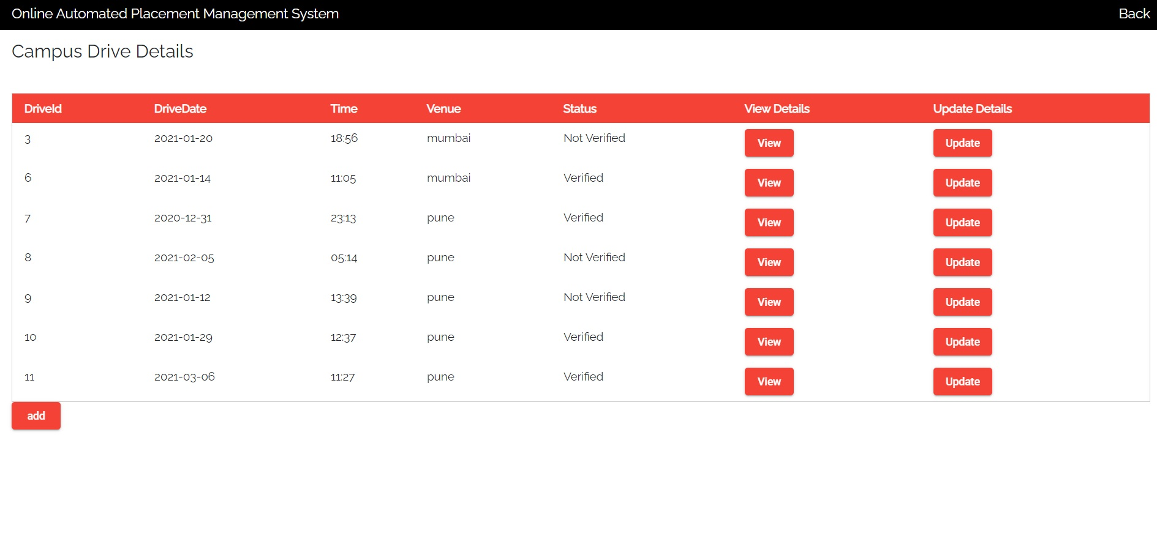
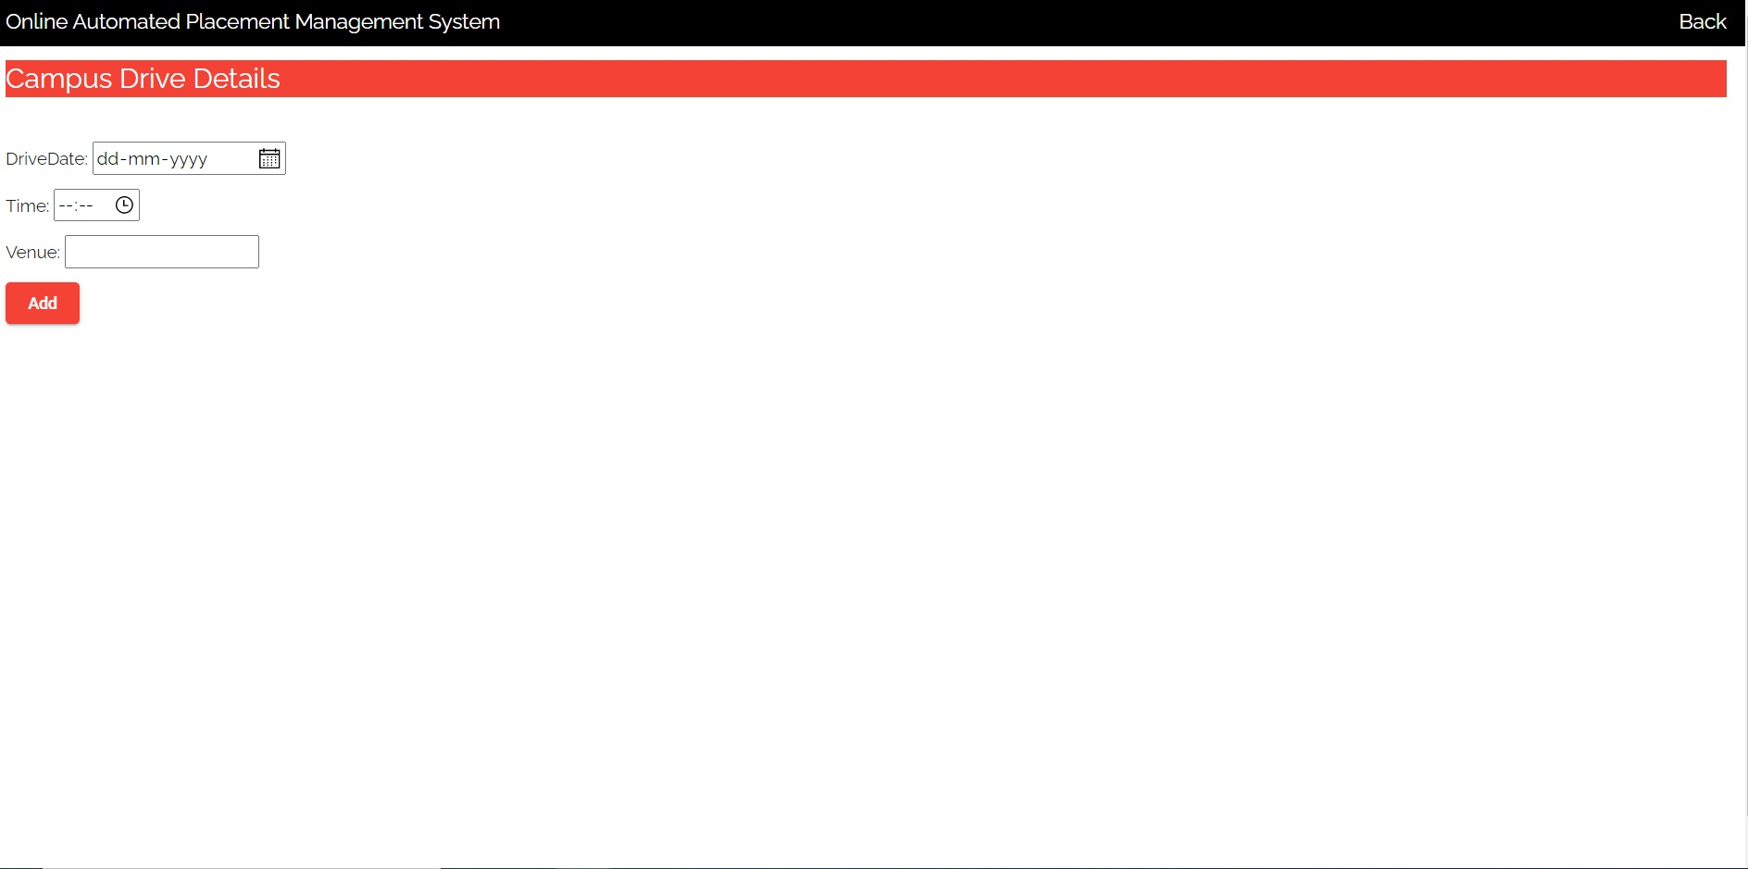
Company functionality
Campus drive
Add drive

Slide 22
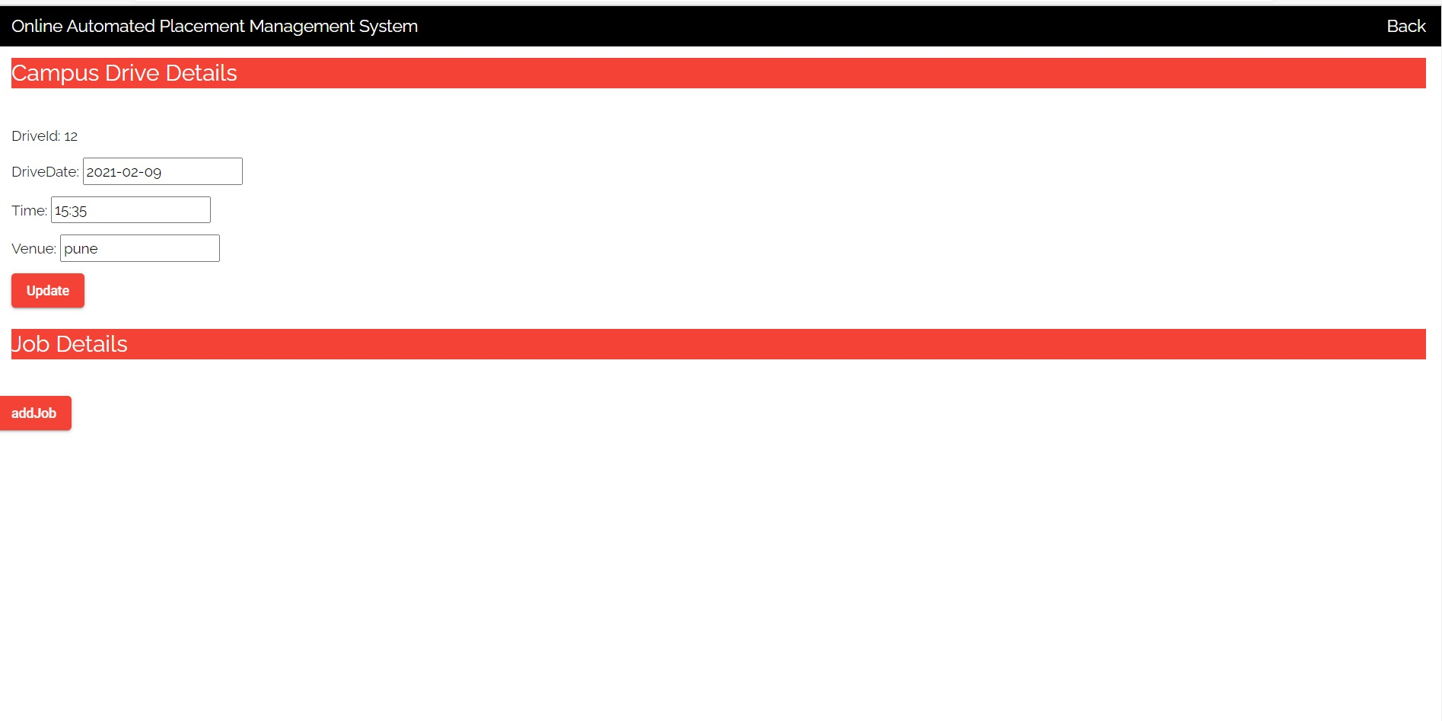
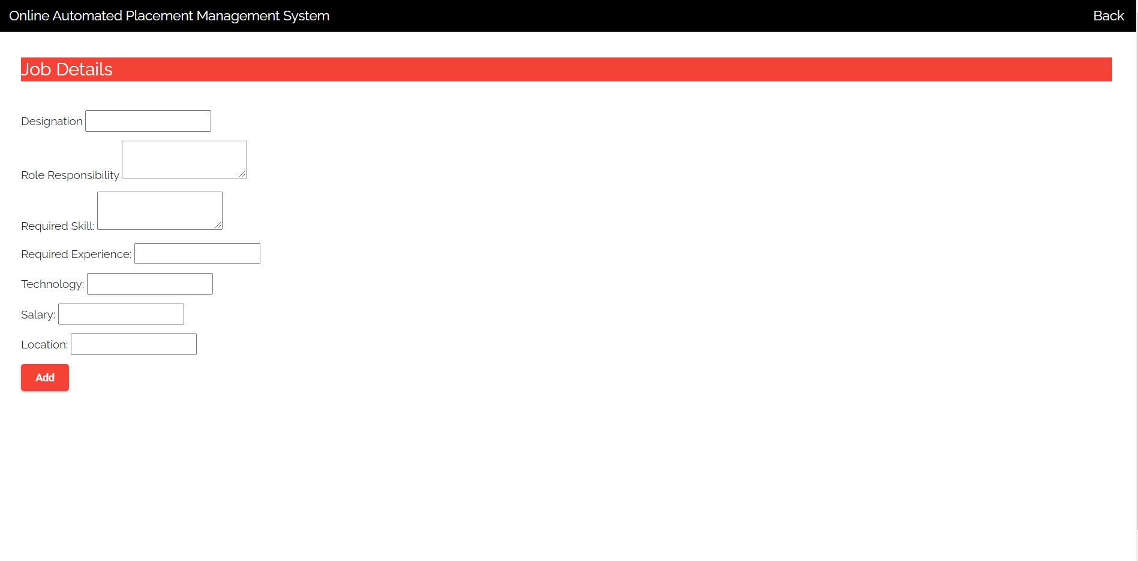
Company functionality
Update DRIVE DETAILS
Add Job details in drive

Slide 23
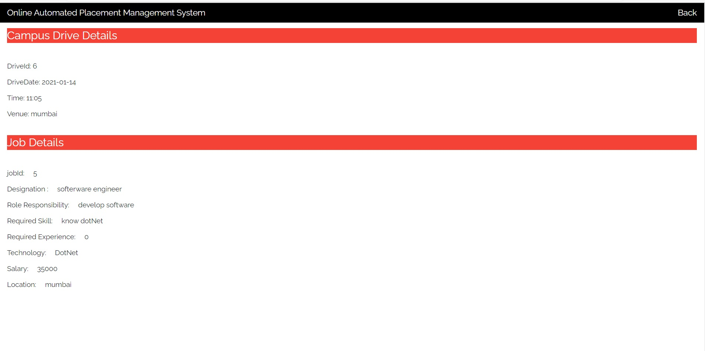
Company functionality
View Drive Details

Slide 24
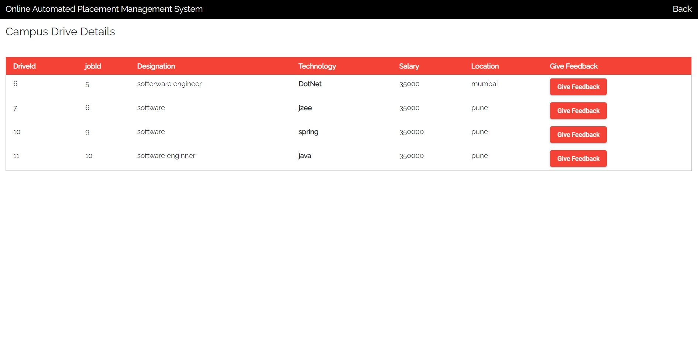
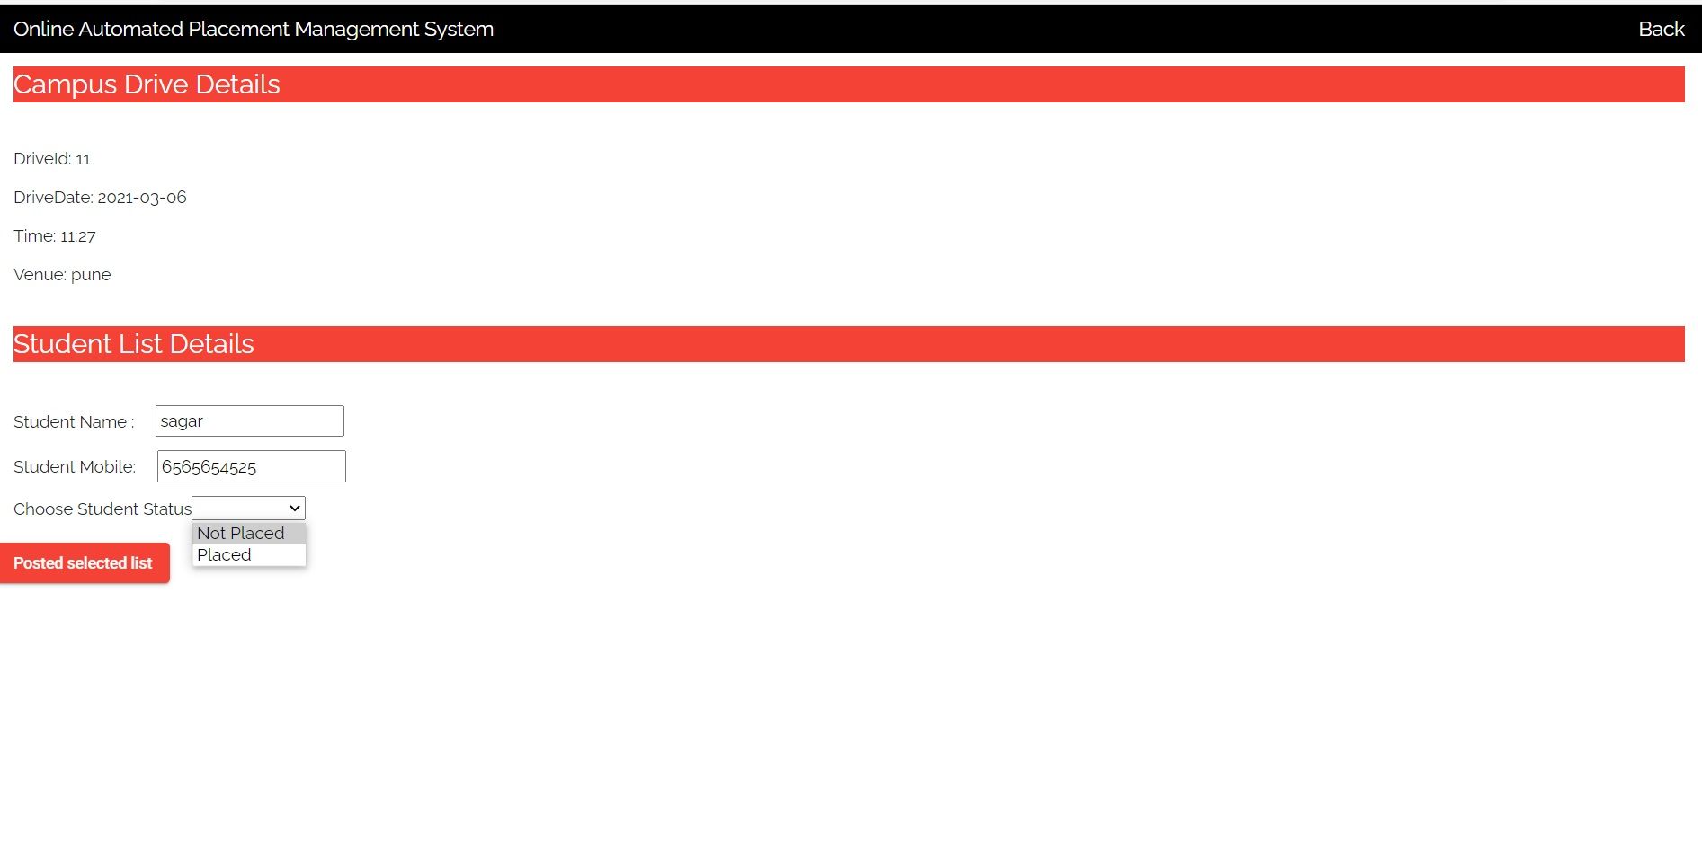
Company functionality
Give feedback
Post list of selected student

Slide 25
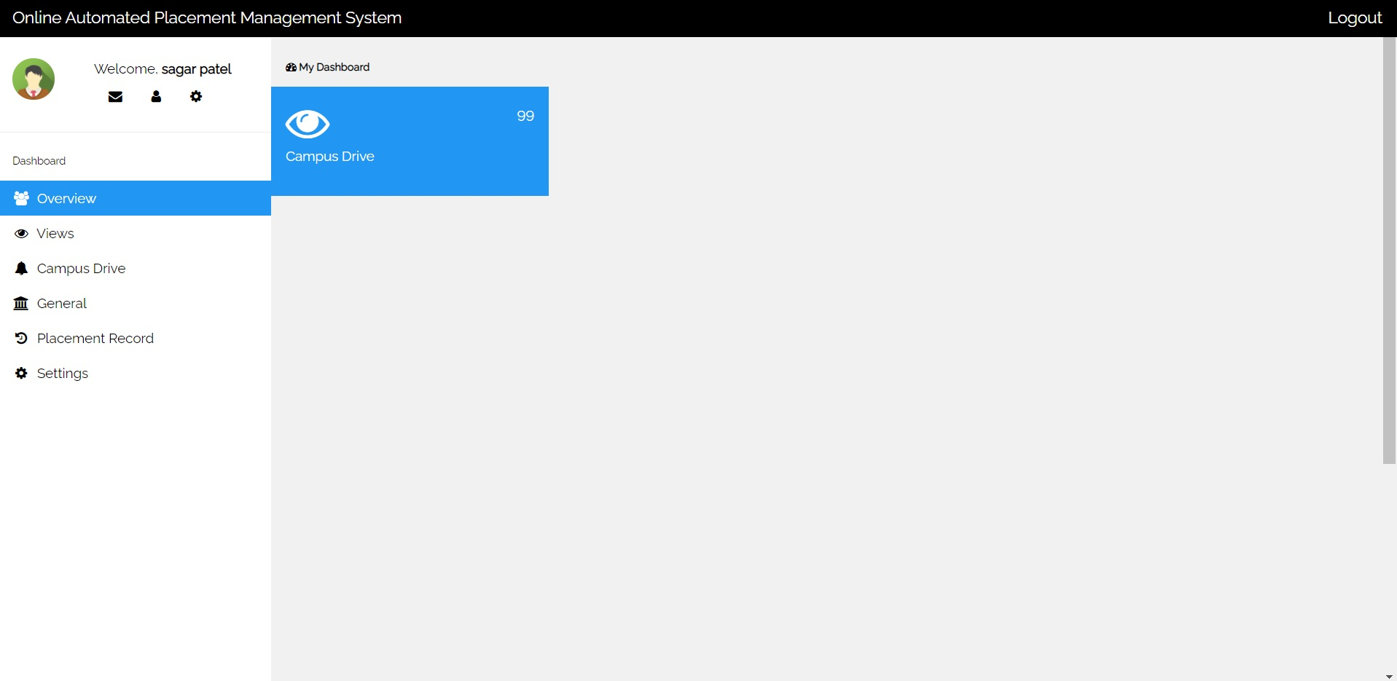
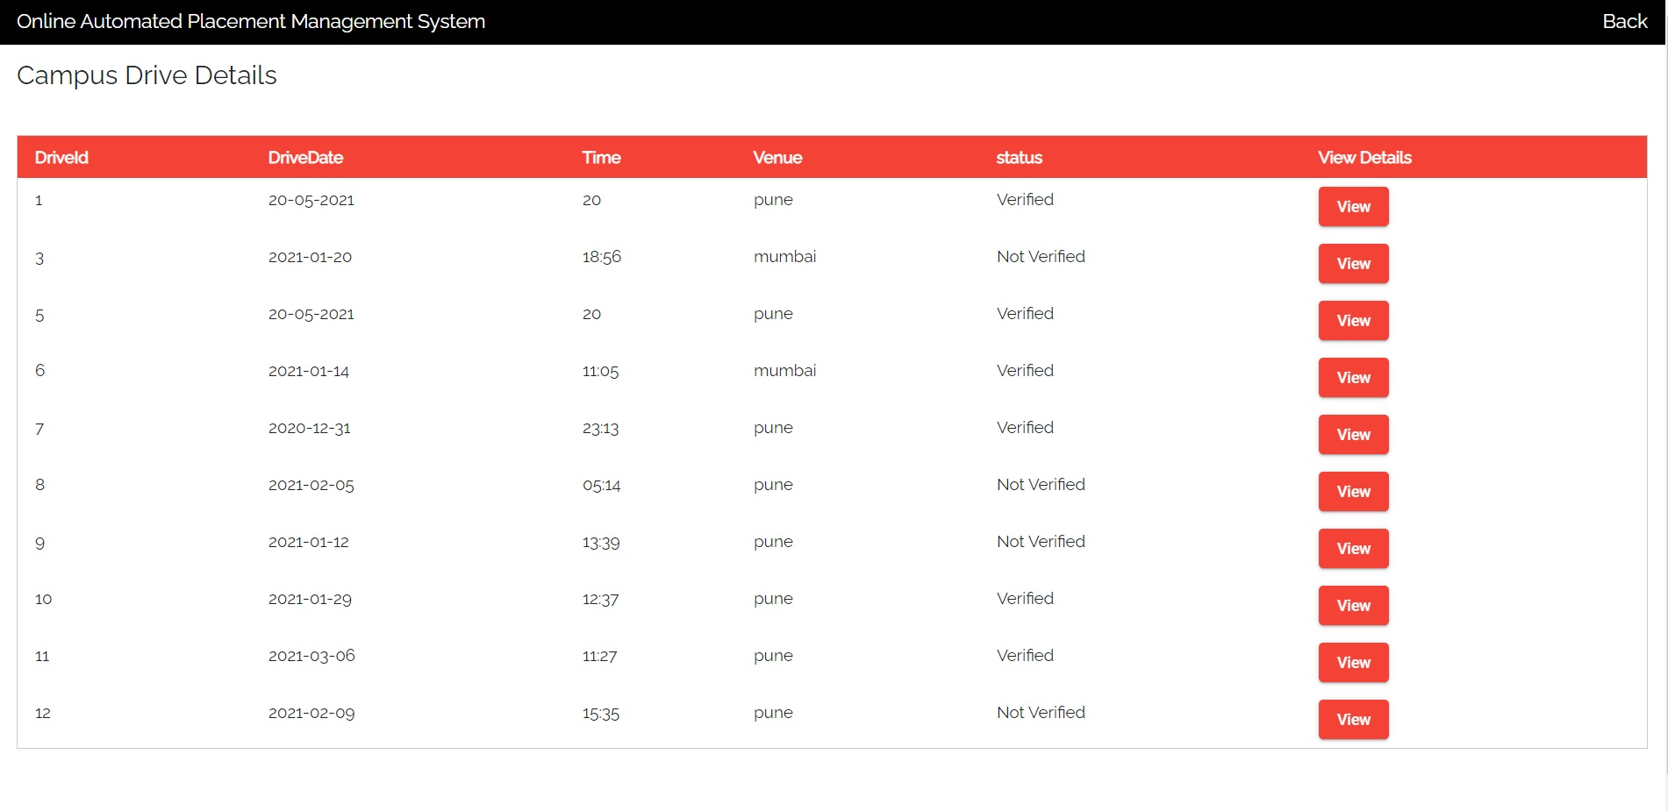
Training placement officer (Tpo) functionality
Tpo Dashboard
List of drive

Slide 26
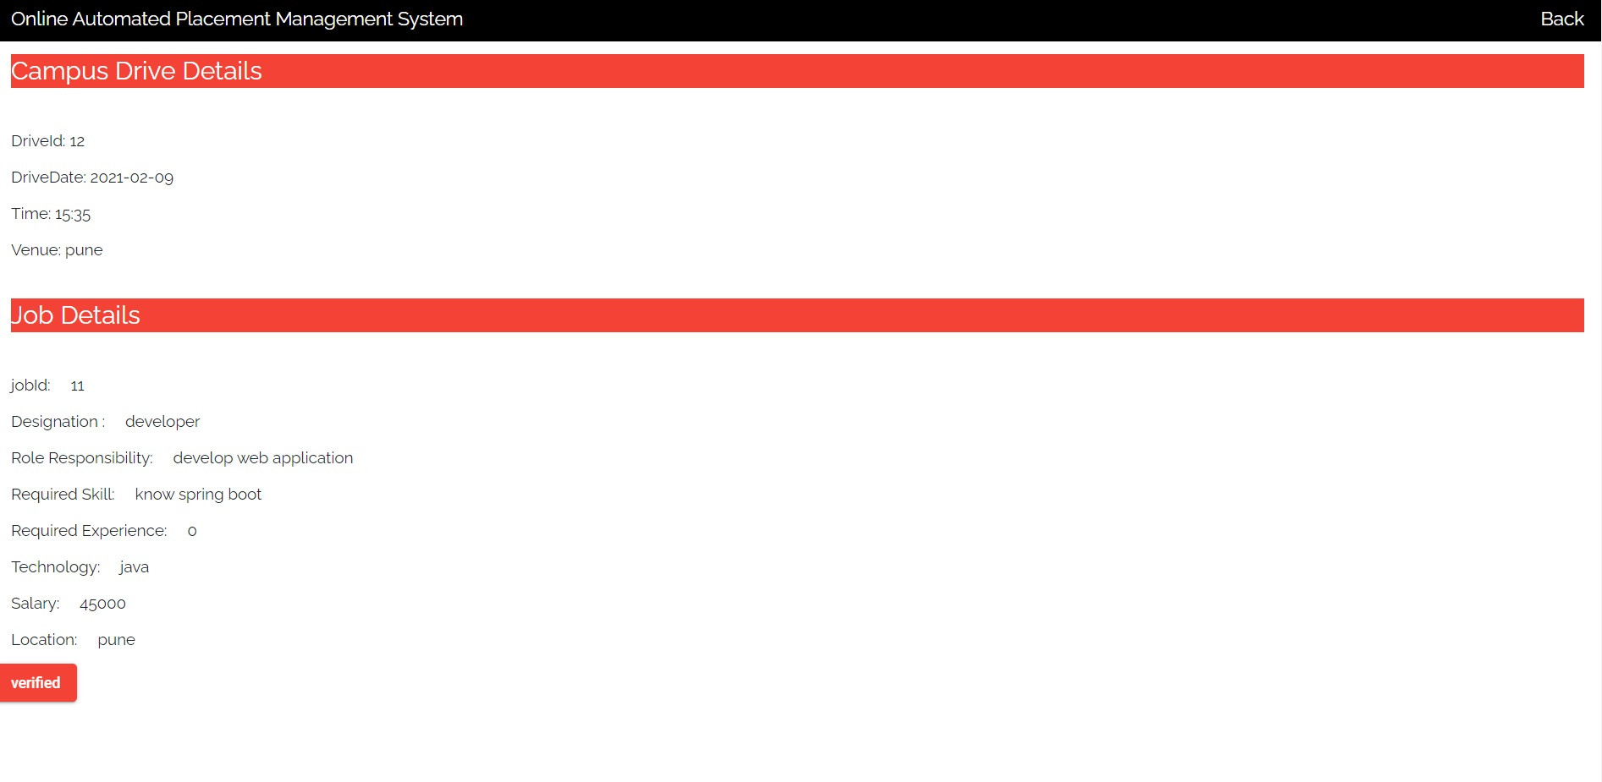
Training placement officer (Tpo) functionality
Verify Drive Details

Slide 27
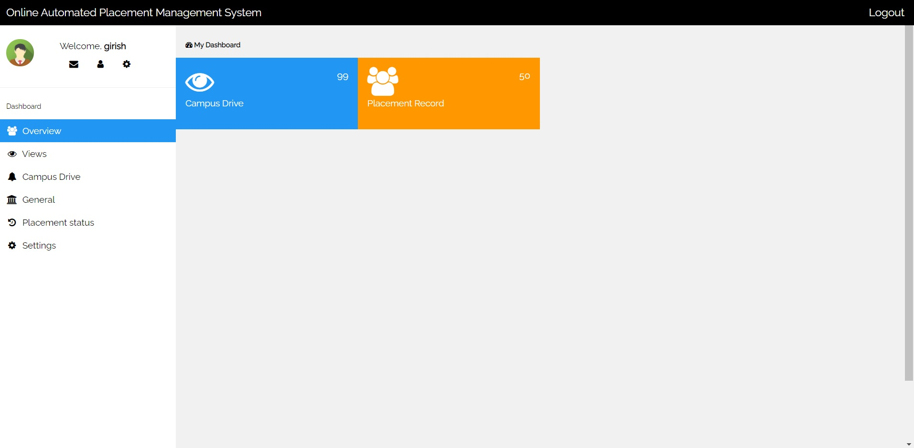
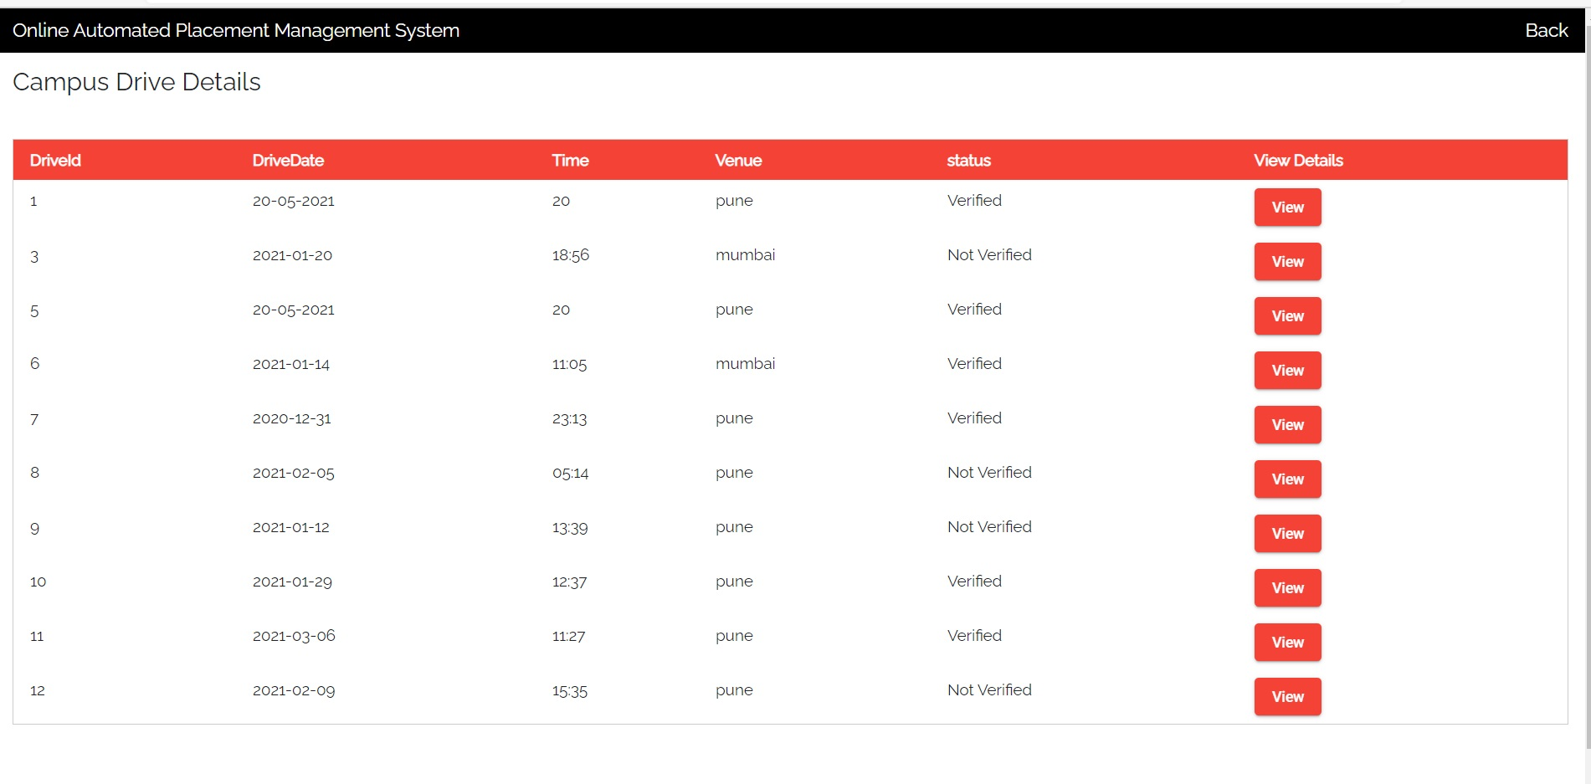
Head of department (hod) functionality
Hod dashboard
Drive detail

Slide 28


